Slide 1
Fixed Wireless Access Overview
Steve Gale – Viavi Solutions
Patrick Davis – Communications Supply Group

Slide 2
Rules for this Session
No Acronyms without explanation – blow the whistle
There are no bad questions – If you are wondering, then someone else is too
If you have an epiphany or experience – share it with us, maybe it will help someone else
We want lots of discussion!

Slide 3
FWA: Another Item On the Menu of Access Technologies
Copper lines are reaching theoretic BW limit (xDSL)
  ILECs are leveraging what is in place, but the end is near.
Fiber (or any “wired” solution) is expensive to deploy
  Includes HFC (DOCSIS)
  Various PON (GPON, XGS-PON, etc.)
Satellite Internet – Wide coverage, but poor throughput/latency
  Might improve with new spectrum and new players (Amazon, Facebook, SpaceX using constellation of Low Earth Orbit satellites
Wireless (terrestrial) can be less expensive to deploy (homes passed basis)
  Particularly if air interface technology is Non-Line of Site
  Some companies can leverage existing wireless assets (think VZW and AT&T)

Slide 4

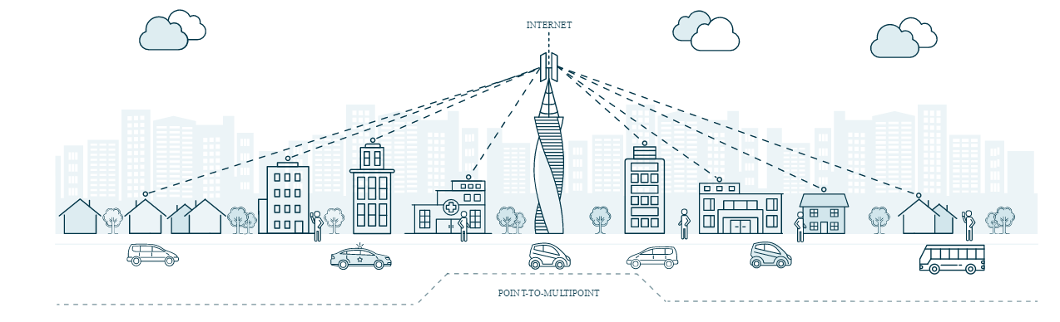
Point to Point and Point to Multi-Point
Source: Airspan Networks

Slide 5
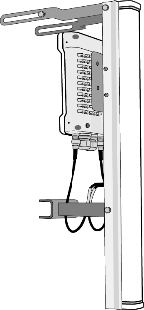



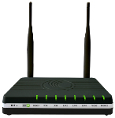
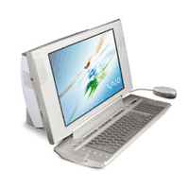
Applications: Residential Broadband (PMP)
Subscriber Module
Base Station
AP Cluster
(Up to 12)
AP: Access Point
SM: Subscriber Module
SS: Surge Suppressor
IP: Internet Protocol
CMM: Cluster Management Module
cnPilot: Cambium ATA Router
CMM
cnPilot R-200
SS
Operator’s
IP Network
Source: Cambium Networks
SS
Notes:
Installers should follow proper safety and grounding procedures, such as use of surge suppressors. Note the placement of grounding wires on each of the masts – part of the AP cluster, on the SM installation mast.
Note the drip loop installed at the SM.
With PMP 54400, each AP should have a surge suppressor attached. (The latest model # is 600 SSD, although the 600 SSC will work.)
Operators can use CMM4 or CMMmicro for the PMP 54400, but if using the CMMmicro, there are limitations on cable length and the number of APs allowed. See the User Guide for details and restrictions.

Slide 6
Fixed Wireless Architecture (PMP)
Most (if not all) now based on an OFDM or OFDMA air interface
Semi-proprietary.
  Air Interface: AP and SM from same company
  Complete System – AP, SM, Management, Planning & Deployment Tools
Using licensed and un-licensed spectrum (900Mhz, 2.4Ghz, 4.9 - 5.9Ghz, etc.)
Various spectral bandwidth (up to 30 or 40 Mhz)
TDD – Time Division Duplex
Network/Access Points schedule the UL air-waves to ensure fairness and so subscribers' traffic does not collide
Use GPS for Sync if multiple Access Points overlapping coverage
Deployment variants employ Omni, Sectorized, MIMO, Beam-forming (DL and UL)
High Gain (up to 24 dBi) customer antennas mounted outside (LOS, nLOS)

Slide 7
CBRS and New 3 GHz Spectrum (150 MHz)
3650 – 3700 MHz already available with license and registration
CBRS PAL Auction anticipated June 2020
Tiered Flexible Use
Opportunity
Establishing a New Common Band
150 MHz
IA
3.4 GHz
3.6 GHz
3.8 GHz
PAL
Band 42 (TDD)
Band 43 (TDD)
50 MHz
Band 48 (TDD)
GAA
6.5 MHz
3.55 GHz
3.7 GHz
Typical Licensed Block
Current 3.65 GHz Spectrum
Incumbents
DoD Radars (coastal areas)
Satellite Earth Stations
Priority Access Licenses (PAL)
Up to 70 MHz of spectrum licensed by auction
General Authorized Access (GAA)
At least 80 MHz nationwide
CBRS
Source: Cambium Networks

Slide 8
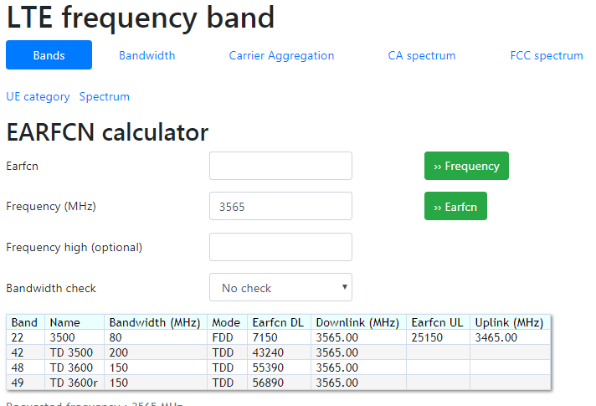
Useful Frequency Band Reference Site
http://niviuk.free.fr/lte_band.php

Slide 9
Spectrum Access Systems (SAS)
The Spectrum Access System (SAS), is an automated frequency coordinator that manages spectrum sharing on a dynamic, as-needed basis across three tiers of access:
Tier 1 is incumbent users such as the federal government, fixed satellite users.
  Environmental Sensing Capability (ESC) in RADAR operation areas
Tier 2 is Priority Access License (PAL) users—licensed wireless users who acquire spectrum through an auction. The SAS will ensure PAL users do not cause harmful interference to Tier 1 users and will protect PAL users from interference by General Authorized Access (GAA) users.
Tier 3 is GAA users who will deploy “lightly-licensed” devices. The SAS will ensure GAA users do not cause harmful interference into Tier 1 incumbents and Tier 2 PAL users.
If spectrum is not being used by one tier it can be accessed by another via the SAS—securely and without harmful interference.
FCC Approved SAS: Amdocs, CommScope, Federated Wireless, Google, Sony

Slide 10
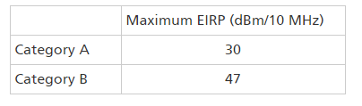
CBRS FCC Part 96 Requirements
Category B Devices must be installed by a Certified Professional Installer (CPI)
Category A Devices installed above 6 Meters and unable to self geo-locate require a CPI.
Online self-paced – half day, ≈ $700

Slide 11
Applications for CBRS Spectrum
Small cell networks: Additional network layers based on small cells will allow for increased capacity where needed the most.
Fixed Wireless Access (FWA): FWA at 3.5 GHz delivers peak rates that few technologies can match without fixed deep fiber.
Neutral Host Networks: With traffic increasingly concentrating indoors, Neutral Host Network operators offer a potential solution to issues associated with legacy technologies (e.g. DAS, Wi-Fi).
Private LTE Networks: Local private network utilizing dedicated radio equipment to service a premise with specific applications and services.
Massive MIMO Hotspot: mMIMO hotspots would serve the needs of high-usage, high-density areas with relatively low mobility.
Industrial IoT: Private LTE or 5G networks on 3.5 GHz could ensure the high reliability and low latency needs for robust IIoT operations.
Macro coverage: Emerging 5G RF technologies could enable a 3.5 GHz layer overlaid on the existing macro grid.

Slide 12
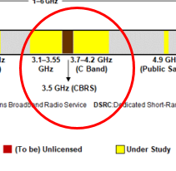
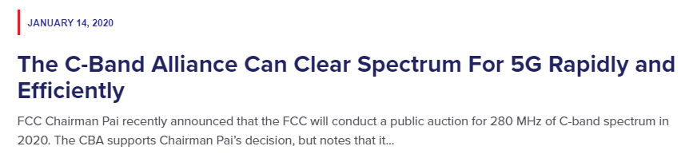
C-Band to bring another 280 MHz of low band Spectrum
3700 – 4200 MHz wide
Used today for Video Distribution
A/D conversion freeing up bandwidth
Video to be repacked into 200 MHz
Filters added to avoid interference
20 MHz guard band
280 Mhz for more consumer Mobility/BB

Slide 13
Overview of LTE

Slide 14
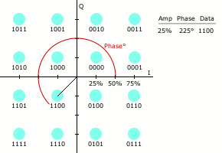

LTE-PHY Overview
LTE Downlink Signal Format – OFDMA
1 Frame (10 ms) = 10 sub-frames (1 ms) = 20 slots (0.5ms)
POWER
POWER
POWER
Transmission
Bandwidth:
9 MHz
Channel
Bandwidth:
10 MHz
FREQUENCY
0
1
2
3
18
19
1 2 3 4 5 6 7
TIME
Slot
Symbols (Sy)
Subframe
Frame
Slot
0
1
2
3
POWER
POWER
Subcarriers (Sc)
Resource
Block
Resource
Element
TIME
TIME
7 Symbol (Sy)
FREQUENCY
15 kHz
FREQUENCY
Symbol (Sy)
12 Subcarrier (Sc)
FREQUENCY
Subcarrier (Sc)
LTE 10 MHz : 9 MHz / 15 kHz = 600 Sc
Resource Block (RB) = 12 Sc x 7 Sy = 84 Resource Elements

Slide 15
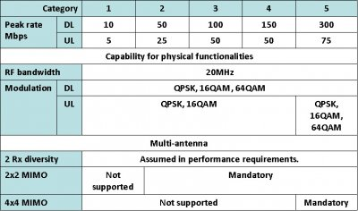
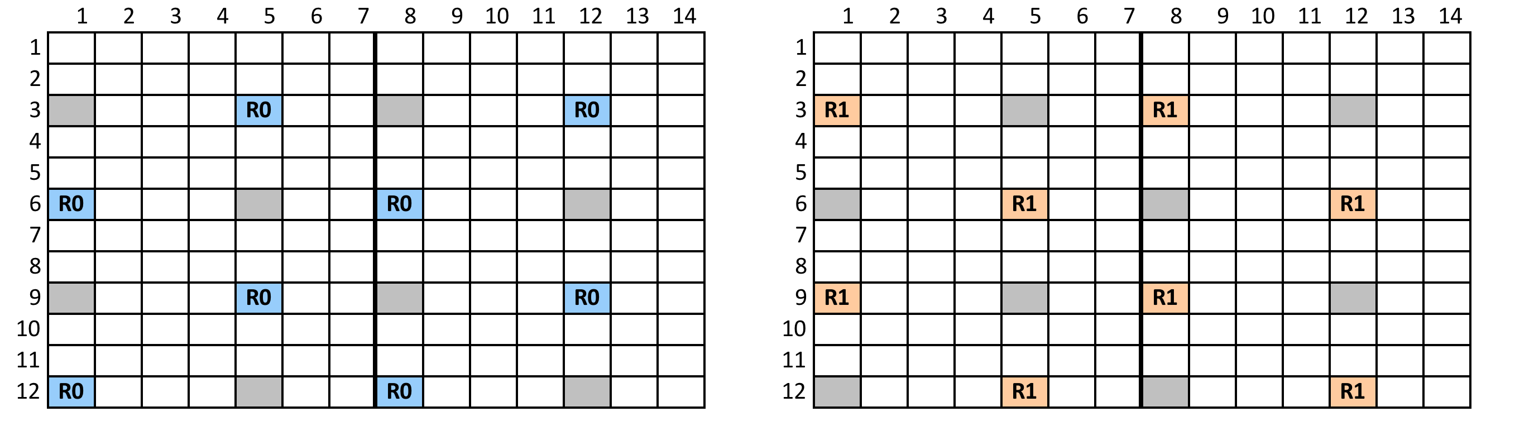
LTE-PHY Overview
MIMO – Multiple In Multiple Out
LTE USER EQUIPMENT CATEGORIES
MIMO REFERENCE SIGNAL LOCATION

Slide 16
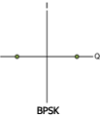
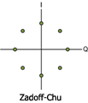
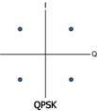
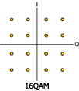
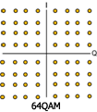
LTE-PHY Overview
LTE Downlink Control Channels
DL Channels | Description | Modulation Format | Purpose
PBCH | Physical Broadcast channel | QPSK | Carrier Cell specific information.
PDCCH | Physical Downlink Control Channel | QPSK | Transports format, resource and hybrid-ARQ information related to DL-SCH, UL-SCH and PCH.
PDSCH | Physical Downlink Shared Channel | QPSK, 16QAM, 64QAM | User data payload.
PMCH | Physical Multicast Channel | QPSK, 16QAM, 64QAM | Payload for multiple users, Multimedia Broadcast Multicast service (MBMS)
PCFICH | Physical Control Format Indicator Channel | QPSK | Carries the number of symbols (1,2 or 3) used for control channels (PDCCH) in a subframe.
PHICH | Physical Hybrid ARQ Indicator Channel | BPSK | Carries the error detection (hybrid ARQ ACK/NAK) feedback to the UE for the UL blocks received by the eNB.
P-SS | Primary Synchronization Signal | Zadoff – Chu | Used for cell search and cell identification. Carries part of the cell ID
S-SS | Secondary Synchronization Signal | BPSK | Used for cell search and cell identification. Carries the remainder of the Cell ID
RS | Reference Signal (Pilot) | Complex I+Q pseudo random sequence | Used for DL channel estimation. Exact sequence derived form Cell ID. Enable UE to calculate transmission corrections.
Page 16
MODULATION SCHEMES
Notes:
16

Slide 17
LTE versus Vendor Proprietary PMP solutions
Advantages | Disadvantages
Proven technology Standards based Wide availability Vendor Interoperability. “Maybe”. Such as the (SM) with (AP) | Built for Mobility, not purpose built for FWA. Encumbered with unnecessary aspects/costs such as an EPC and SIM PMP Vendors more nimble. 3GPP is slow and vendors slower
Frequency reuse of 1 Better nLOS performance. | Beamforming and MIMO not as robust/advanced as some PMP solutions.
Available from large vendors who are global/stable For current Mobility companies, leverage their existing assets

Slide 18
Overview of 5GNR

Slide 19

5G RAN Overview
Network Densification – IoT – Tactile Internet
NETWORK DENSIFICATION
INTERNET OF THINGS
TACTILE INTERNET
Small “Phantom” Cells:
  Massive MIMO (MMIMO)
  mmWave (30GHz, 60GHz, 80GHz)
  MultiRAT (LTE-A and UF-OFDMA)
  Wireless front-haul and back-haul
Macro Cells and DAS
  LTE-APro, WiFiOL, LAA
M2M – LTE-M – NB-IoT
  Smart-Homes
  Remote Control
D2D
Mini-Cloud, Edge-Cloud
  UHD Video
  Augmented Reality
Low latency (1ms)
  Remote Surgery
  Autonomous Cars
  Rescue Robots
  Virtual reality
  Serious gaming
$$\frac{UF−OFDMA}{mmW+MMIMO}$$
5G Evolution
CRAN: Centralized Radio Access Network
LTE-APro: LTE Advanced Pro
LAA: LTE Assisted Access
NB-IoT: Narrowband Internet of Things
LTE-CatM1
µWave: micro-wave
LTE-APro
LTE-CatM
NB-IoT
µWave
$$\frac{UF−OFDMA}{mmW+MMIMO}$$
5G Revolution
mmWave: millimeter wave (30 to 100GHz)
MultiRAT: Multi Radio Access Technology
UF-OFDMA: Universal Filtered OFDMA
LAA
WiFiOL
C-RAN
Notes:
This is a simple overview of 5G RAN, the network densification is going to be realized mainly by the addition of small cells in high frequency spectrum, creating an overlay network with macro-cells in low frequency spectrum… By the way, the reference to high frequency relates to mmWave or 30GHz which will have different challenges and opportunities, for example:
The transmission will be made in new spectrum (28GHz)
The mode of operation is going to be half-duplex or time-division-duplex
Signal propagation will be more sensitive to loss therefore having smaller covering areas
Signal shadowing or loss due to penetration through different building materials and scattering is significantly higher
Now, to overcome some of these challenges, high frequency will allow:
Deployment of smaller antennas, for example an enclosure of 1sq-ft will accommodate 64 antennas, which is referred as massive MIMO
Ability to dynamically adjust each of the beams based on user’s location and motion, through beamforming, allowing to overcome propagation loss and shadowing through diversity or constructing interference of multiple beams.
It is important to notethat these small cells in high-frequency spectrum will co-exist with Macro-cells and DAS systems in low-frequency spectrum which operate in the range of 700MHz to 6GHz… These macro-cells will be delivering evolved LTE services, mainly for carrier aggregation and cell-specific MIMO.
Let me give you a couple of examples,
For indoor applications such as enterprise or even DAS systems in big venues like stadiums and shopping malls it’s going to be more prevalent the use of licensed and unlicensed spectrum, transmitting LTE signals on WiFi frequencies. This is realized with LTE carrier aggregation, and referred as licensed assisted access.
Another example is the notion of phantom-cells, where the control plane is transmitted over macro-cells, and the user-plane is transmitted over small-cells. This is similar to LTE coordinated multi-point or CoMP.
This hybrid and dense network will be able to serve the connectivity of devices or internet of things without compromising high bandwidth or real-time services.
The implementation of this device connectivity will be done in two main modalities, LTE-M and NB-IoT.
In addition to the additional number of cell-sites, signal processing will also be distributed in the form of min—cloud or edge-cloud computing for the effective delivery of mission critical and real-time applications which will allow a tactile internet
In summary, 5G RAN will be composed of two main categories, 5G evolution through existing macro-cells with LTE-Advanced and 5G revolution with the deployment of small-cells in high-frequency with massive-MIMO and beamforming

Slide 20
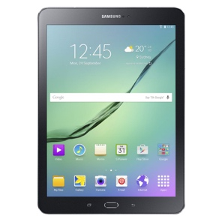
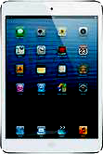
5G RAN Revolution
Massive MIMO and Beamforming
M-MIMO and Beamforming Benefits
Massive MIMO is well suited for higher frequency bands (mmWave), allowing a high array of antennas into a small panel or area.
Beamforming improves signal to noise ratio (SINR) concentrating the energy through narrower beams, as well as creating constructive interference (diversity) overlapping multiple beams to improve propagation.
Massive MIMO
100 m
LTE-A
20cm
Beamforming
20cm

Slide 21
5G Radio Access
3GPP 5G NEW RADIO (NR)
Base Station Type | Test Requirement | Frequency Range | Duplex Mode | Base Station Classes | Output Power | Frequency Error*
1-C | Conducted | FR1 (450 to 6000 MHz) | FDD, TDD, SDL, SUL | Wide Area BS | No Limit | ± 0.05 ppm
 |  |  |  | Medium Range BS | ≤ 38dBm | ± 0.1 ppm
 |  |  |  | Local Area BS | ≤ 24 dBm | ± 0.1 ppm
1-H | Conducted and Over The Air | FR1 (450 to 6000 MHz) | FDD, TDD, SDL, SUL | Wide Area BS | No Limit | ± 0.05 ppm
 |  |  |  | Medium Range BS | ≤ 38dBm | ± 0.1 ppm
 |  |  |  | Local Area BS | ≤ 24 dBm | ± 0.1 ppm
1-O | Over The Air | FR1 (450 to 6000 MHz) | FDD, TDD, SDL, SUL | Wide Area BS | No Limit | ± 0.05 ppm
 |  |  |  | Medium Range BS | ≤ 47 dBm | ± 0.1 ppm
 |  |  |  | Local Area BS | ≤ 33 dBm | ± 0.1 ppm
2-O | Over The Air | FR2 (24250 to 52600 MHz) | TDD | Wide Area BS | No Limit | ± 0.05 ppm
 |  |  |  | Medium Range BS | ≤ 47 dBm | ± 0.1 ppm
 |  |  |  | Local Area BS | ≤ 33 dBm | ± 0.1 ppm
*Observation time of 1ms

Slide 22
5G Radio Access
Communication Modes
Time
Power
UL
Frequency Band | Tx/Rx Mode
FR1 < 3GHz | FDD, TDD, SDL, SUL
FR1 > 3GHz | TDD
FR2 | TDD
DL
DL
3560 MHz
Freq
TDD: Time Division Duplex
Time
Time
DL
Power
DL
Power
UL
UL
739 MHz
751 MHz
751 MHz
782 MHz
782 MHz
Freq
Freq
FDD: Frequency Division Duplex
SDL: Supplemental Downlink

Slide 23
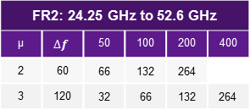
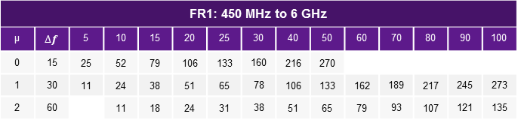
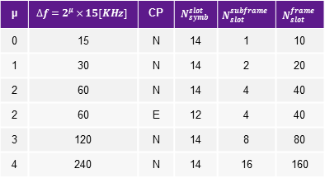
5G Radio Access
5G NR Signal Format (TDD)
POWER
POWER
POWER
FREQUENCY
CH BW: 5, 10… 400 [MHz]
0
1
2
3
4
5
6
7
8
9
1 2 3 4 5 6 7 ……. …..14
TIME
Symbols (Sy)
Subframe
Halfframe 0
Halfframe 1
0
1
2
3
Frame (10ms)
Slot
FR1: 450 MHz to 6 GHz
µ | $$∆f$$ | 5 | 10 | 15 | 20 | 25 | 30 | 40 | 50 | 60 | 70 | 80 | 90 | 100
0 | 15 | 25 | 52 | 79 | 106 | 133 | 160 | 216 | 270
1 | 30 | 11 | 24 | 38 | 51 | 65 | 78 | 106 | 133 | 162 | 189 | 217 | 245 | 273
2 | 60 |  | 11 | 18 | 24 | 31 | 38 | 51 | 65 | 79 | 93 | 107 | 121 | 135
FR2: 24.25 GHz to 52.6 GHz
µ | $$∆f$$ | 50 | 100 | 200 | 400
2 | 60 | 66 | 132 | 264
3 | 120 | 32 | 66 | 132 | 264
µ | $$∆f=2^{μ}×15[KHz]$$ | CP | $$N_{symb}^{slot}$$ | $$N_{slot}^{subframe}$$ | $$N_{slot}^{frame}$$
0 | 15 | N | 14 | 1 | 10
1 | 30 | N | 14 | 2 | 20
2 | 60 | N | 14 | 4 | 40
2 | 60 | E | 12 | 4 | 40
3 | 120 | N | 14 | 8 | 80
4 | 240 | N | 14 | 16 | 160
Source: 3GPP 38.104
Data Modulation
PDSCH | PUSCH
QPSK | QPSK
16QAM | 16QAM
64QAM | 64QAM
256QAM | 256QAM
POWER
Subcarriers (Sc)
µ: subcarrier spacing
CP: cyclic prefix
Source: 3GPP 38.211
FREQUENCY
15 kHz
Resource Block = 12 subcarriers

Slide 24
5G Radio Access
5G NR Numerology
POWER
Subcarriers (Sc)
POWER
1x Slot
Symbols (Sy)
Sub 6GHz
CHBW: 10MHz
µ : 0
Sc: 15KHz
1 slot / subframe
10 slot / frame
140 Sy / frame
15 kHz
CH BW: 10 [MHz]
FREQUENCY
0
1
2
3
4
5
6
7
8
9
TIME
Subframe
Halfframe 1
Halfframe 0
Frame (10ms)
POWER
4x Slots
Symbols (Sy)
POWER
Subcarriers (Sc)
mmWave
CHBW: 100MHz
µ : 2
Sc: 60KHz
4 slot / subframe
40 slot / frame
560 Sy / frame
60 kHz
CH BW: 100 [MHz]
FREQUENCY
0
1
2
3
4
5
6
7
8
9
TIME
Subframe
Halfframe 1
Halfframe 0
Frame (10ms)

Slide 25

5G Radio Access
Massive MIMO Verification
HORIZONTAL
VERTICAL
Phase Array Antenna
8 panels
(1024 Antenna Elements)
Panel with 128 Antenna
(64 cross-polarized antenna elements)
BEAMFORMING

Slide 26
LTE to 5GNR Transition
Non-standalone mode
The non-standalone (NSA) mode of 5G NR refers to an option of 5G NR deployment that depends on the control plane of an existing LTE network for control functions, while 5G NR is exclusively focused on the user plane. This is reported to speed up 5G adoption, however some operators and vendors have criticized prioritizing the introduction of 5G NR NSA on the grounds that it could hinder the implementation of the standalone mode of the network.
Standalone mode
Standalone (SA) mode of 5G NR refers to using 5G cells for both signaling and information transfer. It includes the new 5G Packet Core architecture instead of relying on the 4G Evolved Packet Core, to allow the deployment of 5G without the LTE network. It is expected to have lower cost, better efficiency, and to assist development of new use cases
Dynamic Spectrum Sharing (DSS)
Radios will be capable of dynamically transmitting LTE and 5GNR signals within the same spectrum via frequency and/or time separation. This will allow LTE providers to gradually transition their existing spectrum from 4G to 5G without the traditional hard cut over “refarming” method. Also enables nationwide 5G “claim”

Slide 27
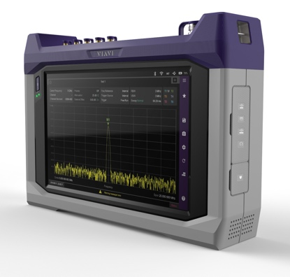
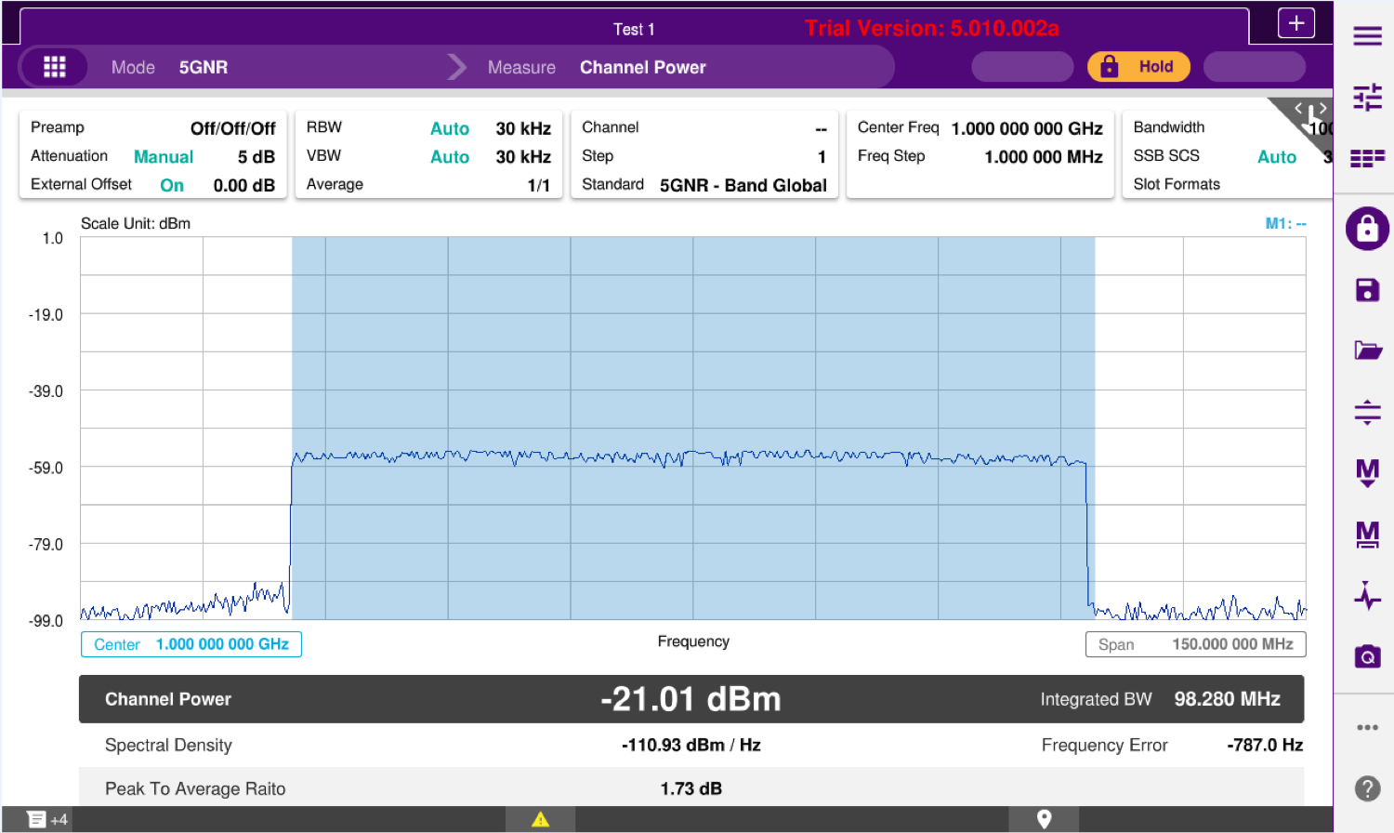
CellAdvisor 5G
RF Characterization and Conformance Test
Adjacent Channel Leakage Ratio
5G RF Characterization
Channel Power, Occupied Bandwidth, ACLR
Spurious Emission Mask

Slide 28
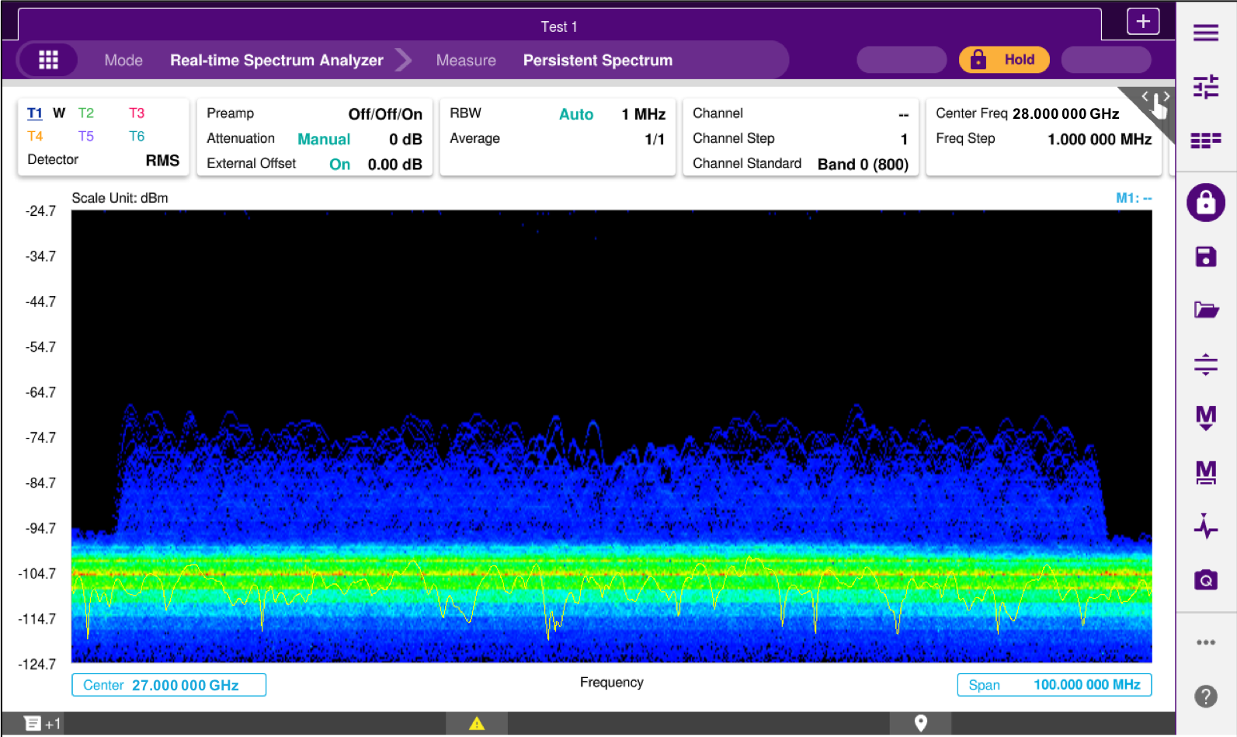
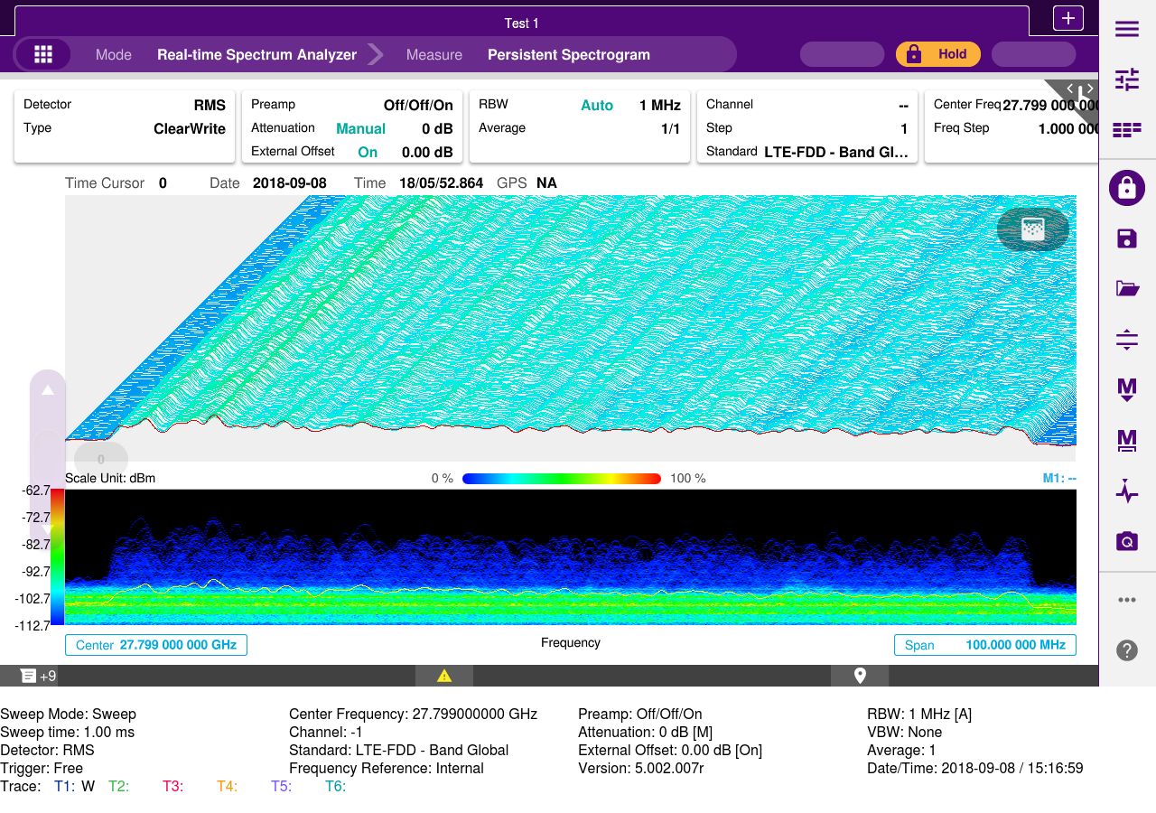
CellAdvisor 5G
Persistence Spectrum and Spectrogram
Persistence Real Time Spectrum
Spectrum Analysis, Spectrogram, 3D Spectrogram
Persistence Real Time Spectrogram
Spectrum Analysis, Spectrogram, 3D Spectrogram

Slide 29

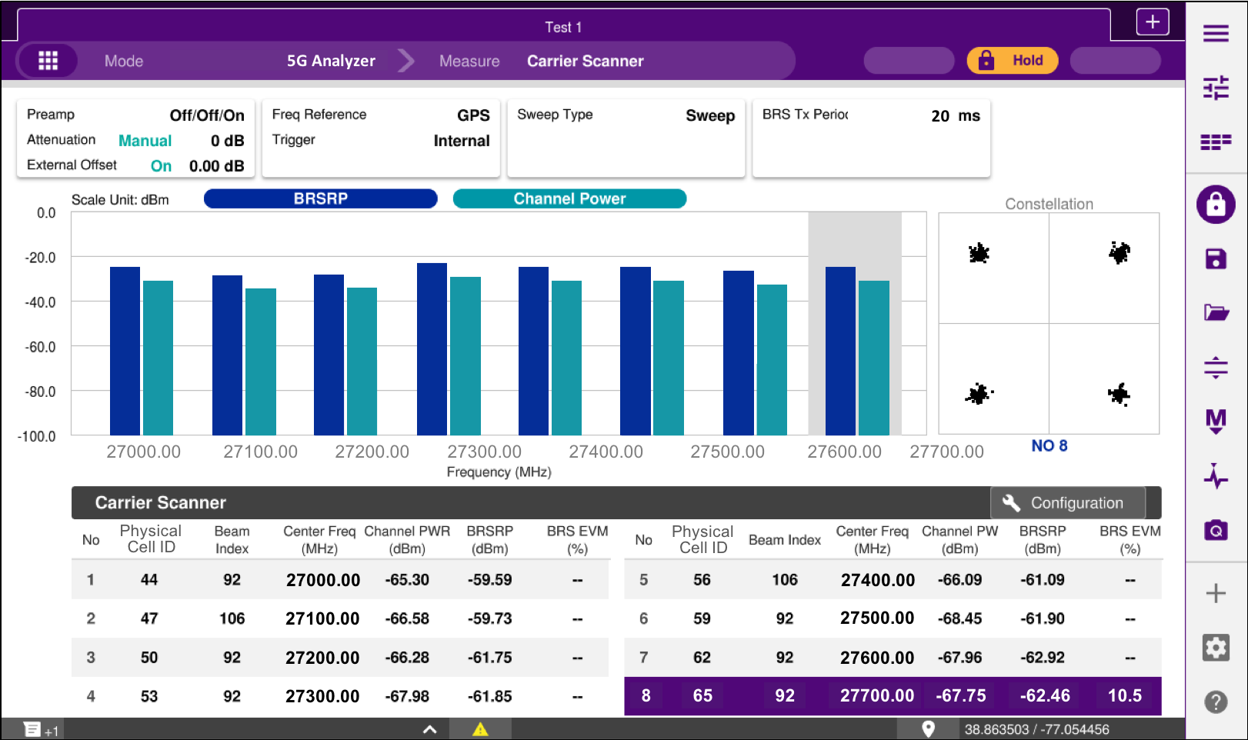
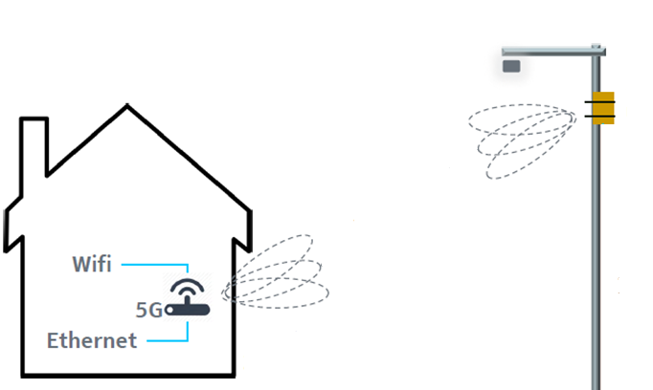
CellAdvisor 5G
5G Carrier Aggregation (x8)
Multi-Carrier Power Balance
  Spectral impairments in mmWave
  Aggregated 100MHz carriers (x8)
  Carrier’s in-band, contiguous and non-contiguous
  Radio’s power performance of all carrier’s
PWR
Carrier Aggregation
FREQUENCY
5G Carrier Scanner (8 component carriers)
Physical Cell ID, Beam ID, Carrier’s Frequency and Power, Beam Power and Quality

Slide 30
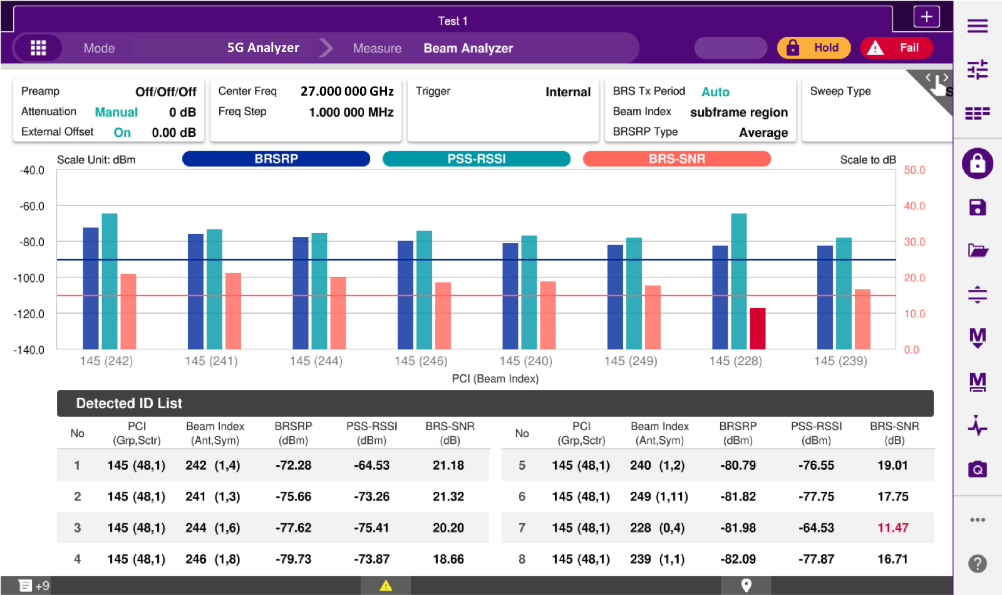
CellAdvisor 5G
5G Beam Analysis
Beamforming Performance
  Increase cell capacity (bandwidth)
  Increase cell coverage (diversity)
Beam 1
Beam 2
Beam n-1
Beam n
5G Beam Analyzer (8 strongest beams)
Physical Cell ID, Beam Index, Beam Power, P-Sync Power, Beam SNR

Slide 31
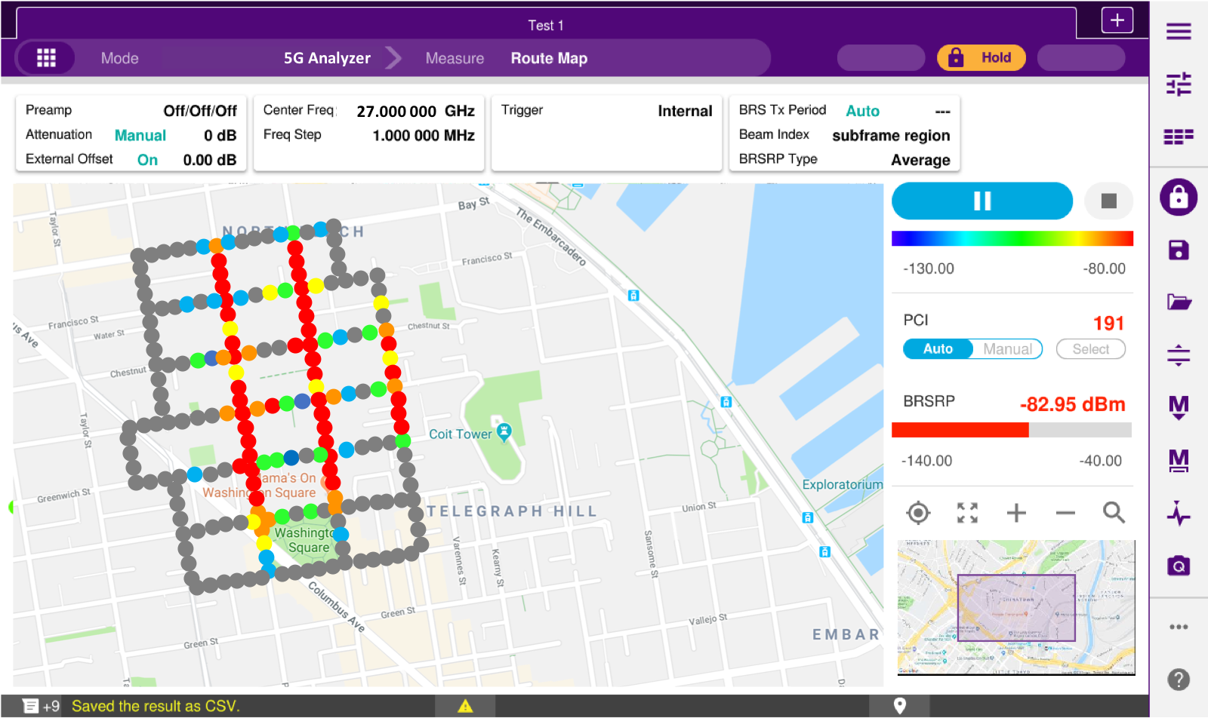
CellAdvisor 5G
5G Route Map Coverage
5G Coverage Mapping
  Cell Coverage
  Beam Availability
  Beam Propagation
5G Route Map (Coverage)
Physical Cell ID, Beam Index, Beam Power, Beam SNR

Slide 32
Test Applications

Slide 33
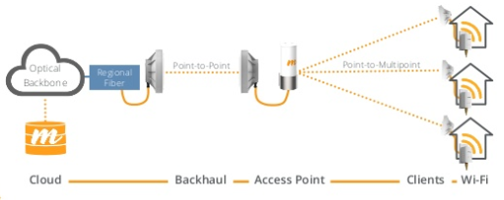
Test Applications in FWA
Core/Lab (EPC) - UE and Core emulation tools. Protocol Analysis. Radio Compliance
Backhaul (MW or wired)
Fiber Inspection, OTDR, Ethernet
RFC2544/ Y.1564
Site – Antenna Alignment, Fiber Inspection, SFP Check, CPRI Check, Coax and Antenna RL
OTA – Signal Validation, Coverage, Interference
Premise – CPE Location, WIFI Quality, Throughput, RFC6349

